Slide 1
Presentation brief for MCT’s
Title of presentation | Creating Bots
Presentation length | 60 minutes.
Audience | Azure AI Engineers, Azure Developers.
Purpose | Introduce the bot framework and services Understand bot design principles Understand how to create a basic bot Learn about the Bot Emulator
(think) Student key takeaways | The student should understand what the bot services are and the bot framework The student should understand the supported environments The student should understand bot interaction channels
(feel) Student desired mindset | The student should understand good bot design principles. The student should be able to determine when a bot is a good approach to a solution
(do) Student outcomes | The student should be able to give examples of bot design considerations The student should be able to create a basic web chat bot The students should be able to download, install, and use the Bot Emulator for bot testing
More information | For course feedback, please use the MCT forums

Slide 2

AI-100T01A Module 02: Creating Bots

Slide 3
Agenda
Overview of the Bot Service
Creating a Basic Chat Bot
Testing with the Bot Emulator
Lab: Basic Filter Bot

Slide 4







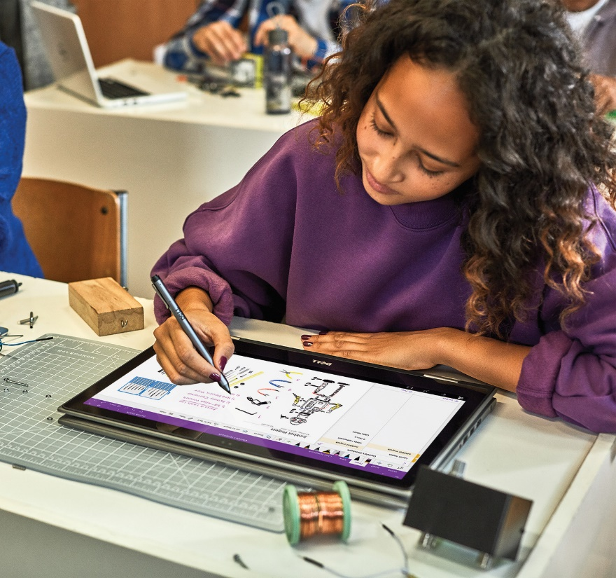


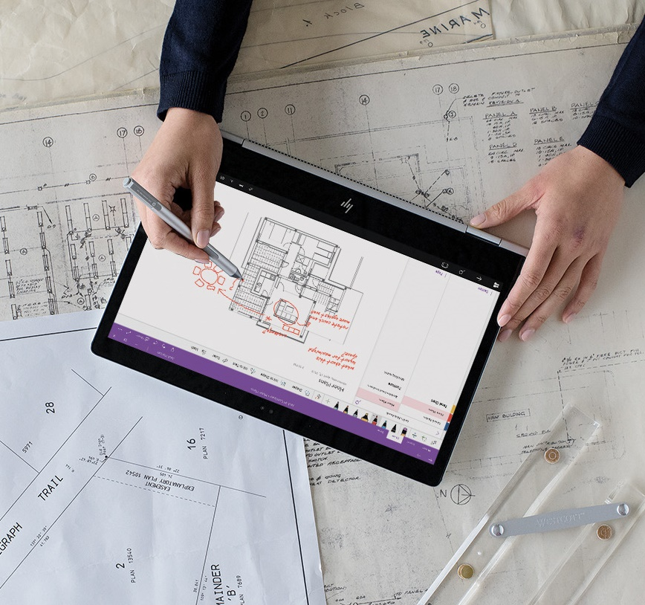


Lesson 01
Introducing the Bot Service
Data
Cloud
AI

Slide 5
Lesson Objectives
L01 – Introduce the Bot Service
L02 – Introduce the Bot Framework
L03 – Introduce Bot Channels

Slide 6
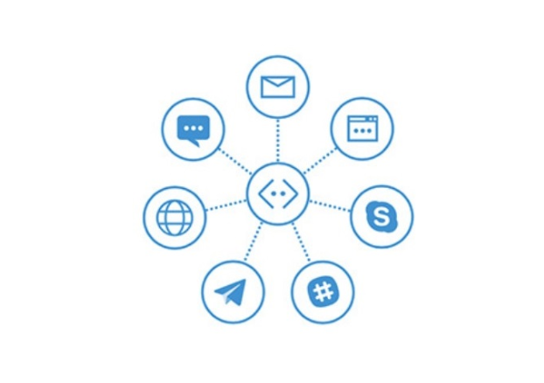
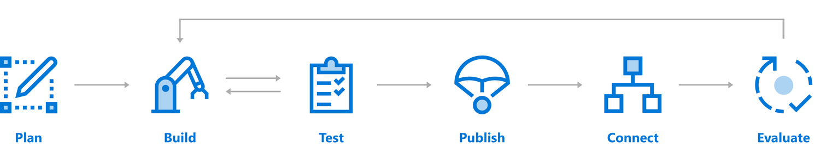
Introduction to the Bot Service and Framework
Bot Dev Lifecycle

Slide 7
The Azure Bot Service
Use Bot Builder SDK or Azure Bot Service to create your bot
Publish it as a web service
Connect channels
Email
Skype
Facebook
Messenger
Slack
Microsoft Teams
Cortana
Text/SMS

Slide 8
Lesson 02
Create a Basic Chat Bot
Data
Cloud
AI

Slide 9
Lesson Objectives
L01 – Understand Bot Design Principles
L02- Understand the Development Environment
L03 – Guided Walkthrough, Create a Basic Chat Bot

Slide 10
Bot Design Principles
Factors that influence success:
Does the bot easily solve the user’s problem with the minimum number of steps?
Does the bot solve the user’s problem better/easier/faster than any of the alternative experiences?
Does the bot run on the devices and platforms the user cares about?
Is the bot discoverable? Do the users naturally know what to do when using it?
Factors that do not guarantee success:
How ‘smart’ the bot is
Depth of natural language support
Voice enabled

Slide 11
Development Environment
Using the SDK, you can build bots that take advantage of the following SDK features:
Powerful dialog system with dialogs that are isolated and composable
Built-in prompts for simple things such as Yes/No, strings, numbers, and enumerations
Built-in dialogs that utilize powerful AI frameworks such as LUIS
FormFlow for automatically generating a bot (from a C# class) that guides the user through the conversation, providing help, navigation, clarification, and confirmation as needed
Environments:
Build using C# and the .NET Framework
Build using JavaScript and Bot Framework SDK for Node.js

Slide 12
Walkthrough – Create a Chat Bot in the Azure Portal
Notes:
Engage the students by having them work along with you in this walkthrough procedure

Slide 13
Lesson 03
Testing with the Bot Emulator
Data
Cloud
AI

Slide 14
Lesson Objectives
L01 – Understand the Bot Emulator
L02 – Explore Bot Emulator Connections

Slide 15
Introducing the Bot Emulator
The Bot Framework Emulator is a desktop application that allows bot developers to test and debug their bots, either locally or remotely.
The Bot Emulator is available for download for:
Windows
Linux
Mac

Slide 16
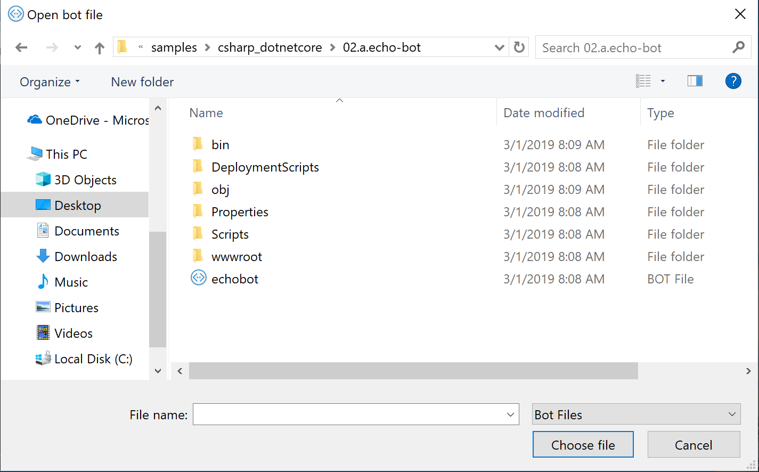
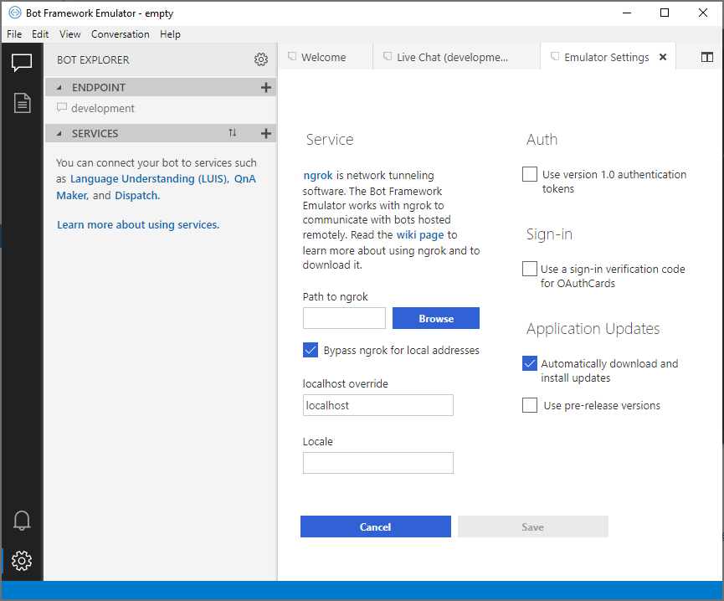
Emulator Connections

Slide 17

Lab 3: Basic Filter Bot

Slide 18
Lab Objectives
Create a Basic Bot in the Azure Portal
Download the Bot Source Code
Modify the Bot Code
Test with the Bot Emulator
Manage State by Logging Conversations

Slide 19
Lab Scenario
In this lab, we will be setting up an intelligent bot from end-to-end that can respond to a user's chat window text prompt. We will be building on what we have already learned about building bots within Azure, but adding in a layer of custom logic to give our bot more bespoke functionality.
This bot will be built in the Microsoft Bot Framework. We will evoke the architecture that enables the bot interface to receive and respond with textual messages, and we will build logic that enables our bot to respond to inquiries containing specific text.
We will also be testing our bot in the Bot Emulator, and addressing the middleware that enables us to perform specialized tasks on the message that the bot receives from the user.
We will evoke some concepts pertaining to Azure Search, and Microsoft's Language Understanding Intelligent Service (LUIS), but will not implement them in this lab.

Slide 20
Lab 4: Log Chat

Slide 21
Lab Objectives
Understand how to intercept and log message activities between bots and users
Log utterances to file storage

Slide 22
Lab Scenario
Now, we wish to log bot chats to enable our customer service team to follow up to inquiries, determine if the bot is performing in the expected manner, and to analyze customer data. This hands-on lab guides you through enabling various logging scenarios for your bot solutions.
In the advanced analytics space, there are plenty of uses for storing log conversations. Having a corpus of chat conversations can allow developers to:
Build question and answer engines specific to a domain.
Determine if a bot is responding in the expected manner.
Perform analysis on specific topics or products to identify trends.

Slide 23
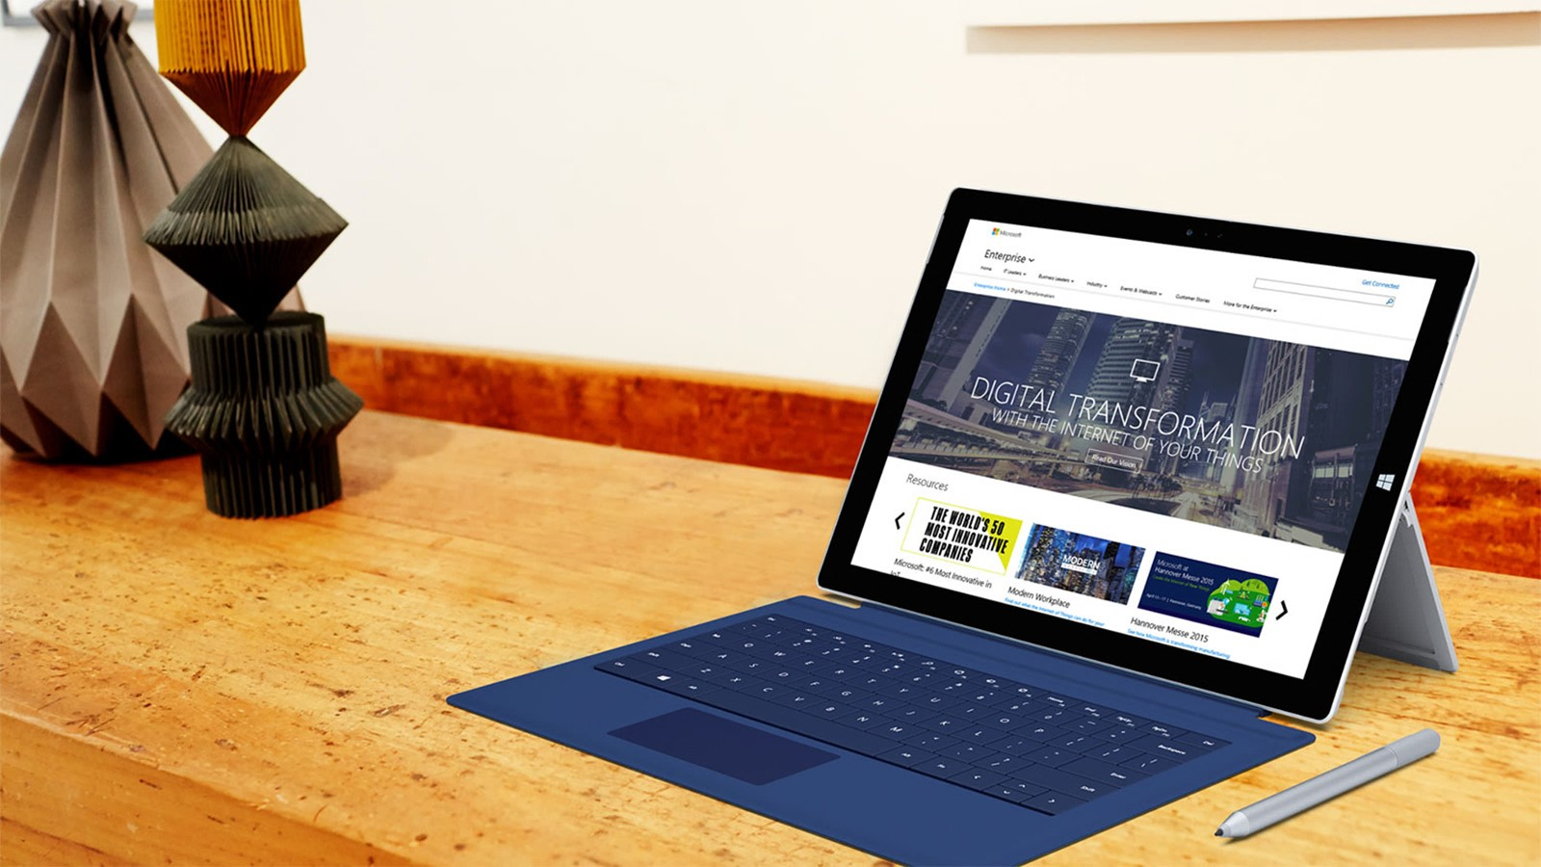
Next steps
Module Summary
In this module, you have learned about:
Microsoft Bot Services
Using the Bot Emulator
How to create a simple Bot
How to Modify the Bot sample code
After the course, consider researching the Bot Framework documentation around the different channels that are supported for communication with the user.

